Slide 1

Azure Multi-Factor Authentication: Who do you think you are?

Slide 2

PhoneFactor acquisition (2012)

Slide 3
Why Multi-Factor Authentication?

Slide 4

Verifying your identities

Slide 5

We need (contextual) multi-factor authentication

Slide 6

When my e-mail address leaks, I change it.
When my password leaks, I change it. When my fingerprint leaks…

Slide 7

Multi-Factor Authentication Methods
Mobile app
Phone call
Text message
Hardware token
One-time Passcode (OTP)
Azure Authenticator app
Push Notifications
Phone Call
Phone Call with PIN
One-way SMS
Two-way SMS
One-way SMS with PIN
Two-way SMS with PIN
OATH-based tokens
Automatic One-time Passcode (OTP) generation
Suppliers: * Yubico Feitian
Secutech
Vasco
Auth
method
Back-end systems
AD FS
RADIUS
IIS Forms-based
MFA Portal
AD FS
RADIUS
IIS Forms-based
MFA Portal
AD FS
RADIUS
IIS Forms-based
MFA Portal
AD FS
RADIUS
IIS Forms-based
MFA Portal
Built-in detection
Fraud detection
Fraud detection
One-way SMS: Fraud detection
Two-way SMS: Fraud detection
Fraud detection
* Not an exclusive list

Slide 8
Multi-Factor Authentication Methods
Method | Strength | Usability
Phone Call – consent mode | ★ | 
Phone Call – PIN mode |  | ★
One Way Text message | ★ | 
Two Way Text message |  | 
Mobile App – consent mode |  | 
Mobile App – One Time Password |  | 
OATH – One Time Password (HW/SW) | ★ | 

Slide 9
Three Types of MFA from Microsoft
Multi-Factor Authentication Server
Azure Multi-Factor Authentication
Office 365 Multi-Factor Authentication

Slide 10

Multi-Factor Authentication Server

Slide 11
Introducing MFA Server
Purchased as a product through the PhoneFactor acquisition in 2012
On-prem server connects to the Internet for MFA
Support for various authentication protocols:
RADIUS
AD FS
LDAP
Windows Authentication (for IIS web sites)
Forms-based Authentication (for IIS web sites)

Slide 12
Licensing MFA Server
MFA Server is licensed through an MFA Provider
Three models for licensing:
Pay per user, enabled in MFA Server
Pay per 10 authentications
Monthly subscription for Azure MFA, or as part of overarching license (Azure AD Premium+, EMS E3+, Microsoft 365 E3+)
Price per licensing model is identical, but mileage may vary

Slide 13
MFA Server Architecture
Microsoft Azure MFA Service
Colleague
MFA-enabled
resources
Azure MFA Server
Active Directory
environment

Slide 14
Designing an MFA Server Implementation
Components
Implementation scenarios
Simple deployment
Redundant deployment
Stretched deployment
Complete deployment
Delegation Model

Slide 15
Implementing MFA Server
Installing and configuring the server
Installing the User Portal (optional)
Installing the Mobile Portal (optional)
Integrating with AD FS
Integrating with RADIUS

Slide 16
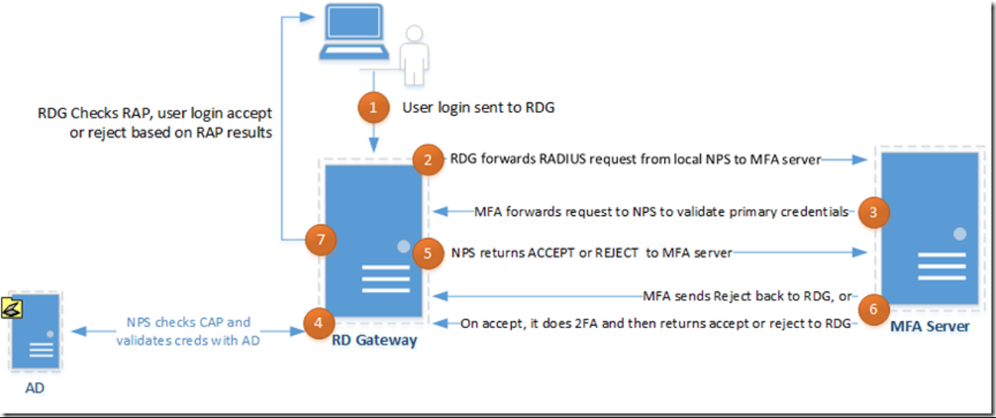
MFA Server and Remote Desktop
Authenticates the RD Gateway
Only consent MFA, No PIN or OTP
MFA Server as RADIUS Proxy

Slide 17
Reporting and MFA Server
PFWEB and the Azure Portal
MFA Server User Interface

Slide 18

Azure Multi-Factor Authentication

Slide 19
Introducing Azure MFA
Uses identities from Azure AD
Builds on PhoneFactor/MFA Server backend
Free for admins in Azure
Cloud based user portal
Successor for MFA Server

Slide 20
Why Azure MFA
Sometimes it's free
Easy to implement
Future proof

Slide 21
Licensing
Azure MFA Server is licensed through the Azure AD Tenant
Monthly subscription for Azure MFA, or as part of overarching license (Azure AD Premium+, EMS E3+, Microsoft 365 E3+)
Azure MFA is free for Azure Admin Roles
Yet, only 0,73% of admins is enabled...

Slide 22

0,73%

Slide 23
Implementing Azure MFA
Enable per user
No delegation possible, need Global Admin privileges
Conditional Access
Azure resources
Azure AD-integrated applications and services
RADIUS MFA Plug-in
Separate download, integrates with NPS
Native AD FS Adapter in AD FS 4.0, and above

Slide 24
Reporting Azure MFA
PowerShell
Graph API
Power BI

Slide 25

Office 365 MFA

Slide 26
Introducing Office 365 MFA
Subset of Azure MFA
Only applicable to Office 365 services
Non-granular
Same authentication factors

Slide 27
Licensing Office 365 MFA
Office 365 Multi-Factor Authentication is licensed through Office 365
Available in all Office 365 subscriptions
Office 365 E1-E5 subscriptions
Office 365 A1-E5 subscriptions
Office 365 Personal, Business, Business Premium
Also available for Office 365 K-subscriptions

Slide 28
Enrolling users into Office 365
Colleague
PROVISION USER
ACCOUNT
LOG ON FOR THE FIRST TIME
PERFORM FIRST MFA
CHANGE PASSWORD
ACCESS TO
OFFICE 365 RESOURCES
PERFORM MFA
SUBSEQUENT LOGONS
*****
*****
AzureAD
Generated password
User-chosen password
AUTOMATION
First name
Last name
…
Phone number
Alternative e-mail address
Admin

Slide 29
Implementing Office 365 MFA
You will need the following privileges in the tenant:
Office 365 Admin
Delegation is not possible
Enable user objects in the Office 365 Portal
Enabled equals enforced after first MFA.

Slide 30
Reporting Office 365 MFA
PowerShell
Graph API
Power BI

Slide 31

Multi-Factor Authentication Recommended Practices

Slide 32
Past and Future of MFA
Microsoft purchased PhoneFactor in 2012
Azure MFA offers DUO, Trusona, etc. as MFA Method since Sept 2017 The Old Portal and the PhoneFactor Web Pages went away 8 jan 2018
Microsoft is moving away from MFA Providers for licensing
RADIUS Plug-in
AD FS Plug-in
MFA Server is going away in favor of lightweight plugins

Slide 33

Implementing MFA Server in the long run

Slide 34
Azure Identity Protection
Microsoft monitors all authentications
Microsoft Azure, Office 365 (OrgIDs)
Microsoft accounts (MSAs, former Windows Live IDs)
Microsoft works together with Google and Facebook, too
Risk score based on context is assigned to every authentication
Default is to perform MFA when account credentials are breached
Azure AD Premium P2 allows managing your organization’s risk scoring

Slide 35
Recommendations
Avoid deploying new MFA Servers (unless for demo purposes ;-) )
Configure MFA Server Portals with a public certificate
Avoid multiple MFA providers in AD FS
Avoid specifying a specific MFA method in claims rules
Don’t onboard thousands of users with MFA Server all at once. Stage.
Every MFA method has its weaknesses. Mitigate.
Update work instructions for contingency situations to the new Azure Portal

Slide 36
Concluding

Slide 37
Concluding
Three types of MFA:
Office 365 MFA
MFA Server
Azure MFA
Deploy in the most beneficial way to your organization
Be granular where possible with Conditional Access, Identity Protection
Choose an MFA solution based on the MFA methods needed
MFA all admins!

Slide 38
Resources
Slides and demos from the conference will be available at github.com/nordicinfrastructureconference/2018 (bit.ly/2y7JhA3)
More info on MFA Server is available at
https://dirteam.com/sander/category/multi-factor-authentication/

Slide 39
Thank you!

